Slide 1
Chapter
8
Securing Information Systems
Notes:
There are three video cases available for this chapter:
Case 1: Stuxnet and Cyber Warfare
Case 2 Cyber Espionage: The Chinese Threat
Case 3: IBM Zone Trusted Information Channel

Slide 2
Essentials of Management Information Systems
Chapter 8 Securing Information Systems
STUDENT LEARNING OBJECTIVES
Why are information systems vulnerable to destruction, error, and abuse?
What is the business value of security and control?
What are the components of an organizational framework for security and control?
What are the important tools and technologies for safeguarding information resources?
Notes:
This chapter discusses the need for security to guard information systems and data as well as technologies used secure information systems. Ask students what types of threats can harm an information system. Internet security, or the lack thereof, will continue to be a topic of major concern to corporations and countries. Ask students why there is so much attention paid to Internet security issues in the press. Have any students been a victim of computer crime, or know of a victim?

Slide 3
Essentials of Management Information Systems
Chapter 7 Telecommunications, the Internet, and
Wireless Technology
Student Support Materials
Learning Tracks
The Booming Job Market in IT Security
The Sarbanes Oxley Act
Computer Forensics
General and Application Controls for Information Systems
Management Challenges of Security and Control
Software Vulnerability and Reliability
Video Cases
Case 1: Stuxnet and Cyberwarfare
Case 2: Cyberespionage: The Chinese Threat
Case 3: IBM Zone Trusted Information Channel (ZTIC)
Instructional Video 1: Sony PlayStation Hacked; Data Stolen from 77 Million Users
Instructional Video 2: Zappos Working to Correct Online Security Breach
Instructional Video 3: Meet the Hackers: Anonymous Statement on Hacking SONY

Slide 4
Essentials of Management Information Systems
Chapter 8 Securing Information Systems
MiniDuke Exposes EU Cybersecurity Gaps
Problem
  Security breach infects government computers in over 20 European countries
  Leak of geopolitical intelligence
  Fragmented approach to cybersecurity in the EU leads to disjointed and disparate policies, and unequal levels of protection.
Notes:
Ask students to talk about their own experiences with spam, malware, and security issues.

Slide 5
Essentials of Management Information Systems
Chapter 8 Securing Information Systems
MiniDuke Exposes EU Cybersecurity Gaps
ENISA urged implementation of a common cybersecurity strategy but EC3 has not been able to stipulate a clear definition for cyber security.
Illustrates: Lack of a centralized and cohesive approach to cybersecurity
Demonstrates: Need for updating security policies continuously and convincing member nations to participate in a consistent, common cybersecurity strategy.
Notes:
Ask students if they have social networking accounts and have they experienced security issues? Do they believe they are more or less likely to be hacked on LinkedIn and Facebook compared to email? Most social network malware attacks are “social engineering” attacks which rely on the gullibility of users. Note that the cost of ensuring adequate security would be far less than a multimillion dollar lawsuit.

Slide 6
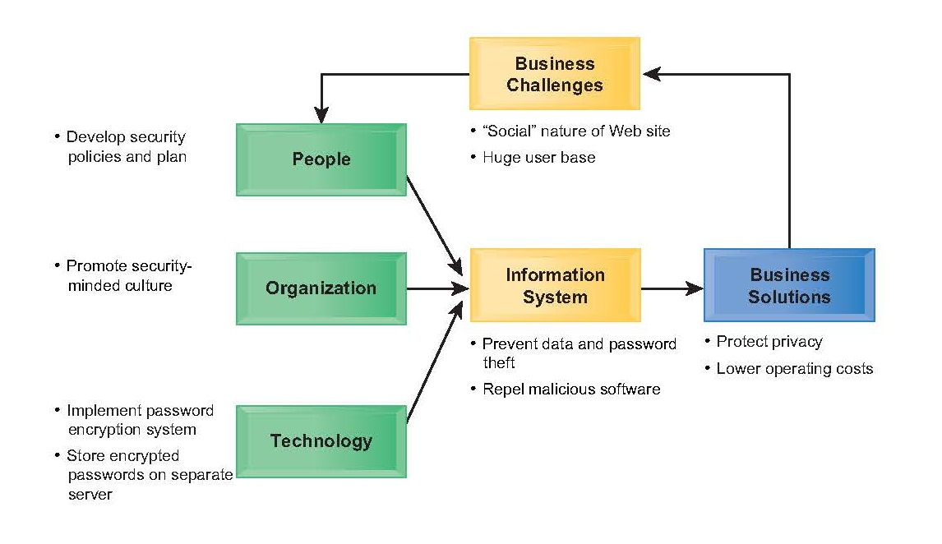
Essentials of Management Information Systems
Chapter 8 Securing Information Systems
MiniDuke Exposes EU Cybersecurity Gaps

Slide 7
Essentials of Management Information Systems
Chapter 8 Securing Information Systems
Why Are Information Systems Vulnerable?
An unprotected computer connected to Internet may be disabled within seconds
Security:
  Policies, procedures, and technical measures used to prevent unauthorized access, alteration, theft, or physical damage to information systems
Controls:
  Methods, policies, and organizational procedures that ensure safety of organization’s assets; accuracy and reliability of its accounting records; and operational adherence to management standards
Notes:
This slide introduces the need for both security and controls in today’s businesses in order to safeguard information systems. Ask students to give an example of a security technique and an example of a control that might be used in a business.

Slide 8
Essentials of Management Information Systems
Chapter 8 Securing Information Systems
Why Are Information Systems Vulnerable?
Why Systems Are Vulnerable
Hardware problems
  Breakdowns, configuration errors, damage from improper use or crime
Software problems
  Programming errors, installation errors, unauthorized changes
Disasters
  Power failures, flood, fires, and so on
Use of networks, computers outside of firm’s control
  Domestic or offshore outsourcing vendors
  Mobile devices
Notes:
This slide discusses the main categories of threats to information systems. Note that when large amounts of data are stored digitally, on computers and servers and in databases, they are vulnerable to many more kinds of threats than when they were stored in manual form, on paper in folders and file cabinets. When data are available over a network, there are even more vulnerabilities. Ask students if they have ever lost data on their computers. What was the reason (hardware, software, “disaster,” other people, etc.).

Slide 9
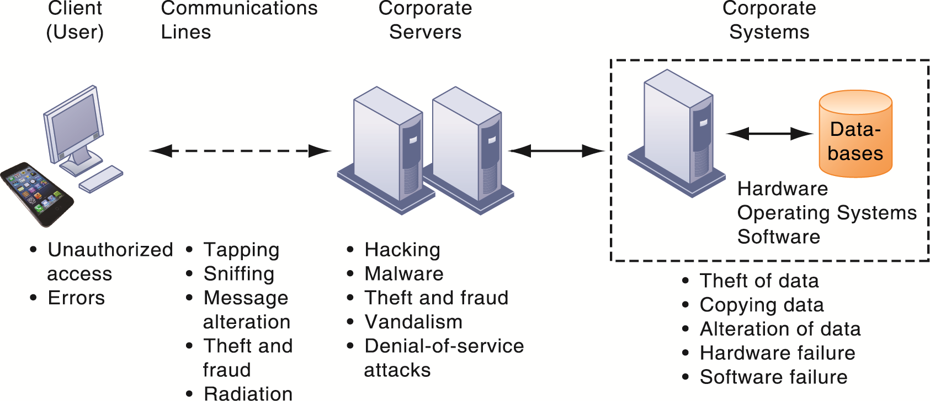
Essentials of Management Information Systems
Chapter 8 Securing Information Systems
Why Are Information Systems Vulnerable?
Contemporary Security Challenges and Vulnerabilities
Figure 8.1
The architecture of a Web-based application typically includes a Web client, a server, and corporate information systems linked to databases. Each of these components presents security challenges and vulnerabilities. Floods, fires, power failures, and other electrical problems can cause disruptions at any point in the network.
Notes:
This graphic illustrates the types of threats to system security and the points over the network at which these threats are prevalent. Some problems occur at the client computer, others through the network lines, corporate servers, or in corporate hardware and software.

Slide 10
Essentials of Management Information Systems
Chapter 8 Securing Information Systems
Why Are Information Systems Vulnerable?
Internet vulnerabilities
  Network open to anyone
  Size of Internet means abuses can have wide impact
  Use of fixed Internet addresses with permanent connections to Internet eases identification by hackers
  E-mail attachments, file downloading and sharing
  E-mail used for transmitting trade secrets
  IM messages lack security, can be easily intercepted
Notes:
This slide discusses the types of threats that large public networks, like the Internet, face because they are open to virtually anyone. Note that the Internet is so huge that when abuses do occur, they can have an enormously widespread impact. And when the Internet becomes part of the corporate network, the organization’s information systems are even more vulnerable to actions from outsiders.
Ask students to think about recent failures in large public networks. How did these failures occur? Was it poor security technology or management failure? Human vulnerability?

Slide 11
Essentials of Management Information Systems
Chapter 8 Securing Information Systems
Why Are Information Systems Vulnerable?
Wireless security challenges
  Radio frequency bands easy to scan
  SSIDs (service set identifiers)
    Identify access points.
    Broadcast multiple times.
  War driving
    Eavesdroppers drive by buildings and try to intercept network traffic
    With access to SSID, has access to network’s resources
  Rogue access points
Notes:
This slide discusses security threats related to wireless networks. Local-area networks (LANs) using the 802.11 standard can be easily penetrated by outsiders armed with laptops, wireless cards, external antennae, and hacking software. Hackers use these tools to detect unprotected networks, monitor network traffic, and, in some cases, gain access to the Internet or to corporate networks. Ask students if they have connected to the Internet through an unknown wireless network that a person or business had established and left unprotected.

Slide 12
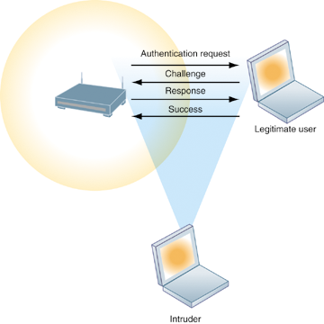
Essentials of Management Information Systems
Chapter 8 Securing Information Systems
Why Are Information Systems Vulnerable?
Wi-Fi Security Challenges
Figure 8.2
Many Wi-Fi networks can be penetrated easily by intruders using sniffer programs to obtain an address to access the resources of a network without authorization.
Notes:
This graphic illustrates why wireless networks are vulnerable—the service set identifiers (SSIDs) identifying the access points in a Wi-Fi network are broadcast multiple times (as illustrated by the orange sphere) and can be picked up fairly easily by intruders’ sniffer programs.

Slide 13
Essentials of Management Information Systems
Chapter 8 Securing Information Systems
Why Are Information Systems Vulnerable?
Malicious Software: Viruses, Worms, Trojan Horses, and Spyware
Malware
  Viruses
    Rogue software program that attaches itself to other software programs or data files in order to be executed
  Worms
    Independent computer programs that copy themselves from one computer to other computers over a network
  Trojan horses
    Software program that appears to be benign but then does something other than expected.
Notes:
This slide identifies the various types of malware that threaten information systems and computers. Ask students if they have ever had a problem with a virus. Do they know how they got infected? Note that there are now over 3600 viruses and worms targeting mobile devices. Facebook, Twitter, and LinkeIn are also conduits for malware and spyware. Malware is a serious problem—over the past decade, worms and viruses have caused billions of dollars of damage to corporate networks, e-mail systems, and data.

Slide 14
Essentials of Management Information Systems
Chapter 8 Securing Information Systems
Why Are Information Systems Vulnerable?
Malicious Software: Viruses, Worms, Trojan Horses, and Spyware
  SQL injection attacks
  Spyware
    Small programs install themselves surreptitiously on computers to monitor user Web surfing activity and serve up advertising
  Key loggers
    Record every keystroke on computer to steal serial numbers, passwords, launch Internet attacks
Notes:
SQL injection attacks are one of the top five most common form of attacks against large SQL databases operated by government agencies and corporations. In an SQL injection attack, malicious code is entered into the database by one or several users filling out typical online forms with the intent of taking over the database and downloading data to hacker Web sites. SQL attacks can be prevented by installing proper security software and properly editing data input from user forms.

Slide 15
Essentials of Management Information Systems
Chapter 8 Securing Information Systems
Why Are Information Systems Vulnerable?
Hackers and Computer Crime
  Hackers versus crackers
  Activities include:
    System intrusion
    Theft of goods and services
    System damage
    Cybervandalism — Intentional disruption, defacement, destruction of Web site or corporate information system
Notes:
This slide looks at the people who commit computer crime, and at the various types of computer crime.
Ask students what the difference is between hackers and crackers and if they agree with the distinction. Have any students been the victim of computer crime or invasion of privacy?

Slide 16
Essentials of Management Information Systems
Chapter 8 Securing Information Systems
Why Are Information Systems Vulnerable?
Hackers and Computer Crime
Spoofing
  Misrepresenting oneself by using fake e-mail addresses or masquerading as someone else
  Redirecting Web link to address different from intended one, with site masquerading as intended destination
Sniffer
  Eavesdropping program that monitors information traveling over network
  Enables hackers to steal proprietary information such as e-mail, company files, and so on
Notes:
This slide continues the discussion of different types of computer crimes. Ask students what the ultimate purpose of spoofing and sniffing are. Note that there are legitimate uses of sniffing—sniffers can help identify network trouble spots or spot criminal activity on a network. What is the result of a DoS attack?

Slide 17
Essentials of Management Information Systems
Chapter 8 Securing Information Systems
Why Are Information Systems Vulnerable?
Hackers and Computer Crime
Denial-of-service attacks (DoS)
  Flooding server with thousands of false requests to crash the network.
Distributed denial-of-service attacks (DDoS)
  Use of numerous computers to launch a DoS
  Botnets
    Networks of “zombie” PCs infiltrated by bot malware

Slide 18
Essentials of Management Information Systems
Chapter 8 Securing Information Systems
Why Are Information Systems Vulnerable?
Hackers and Computer Crime
Computer crime
  Any violations of criminal law that involve a knowledge of computer technology for their perpetration, investigation, or prosecution
  Computer may be target of crime:
    Breaching confidentiality of protected computerized data
    Accessing a computer system without authority
  Computer may be instrument of crime:
    Theft of trade secrets
    Using e-mail for threats or harassment
Notes:
This slide discusses the legal definition of computer crime and identifies two ways computers can be involved in crime.
The text lists a variety of other examples for computers as targets and as instruments of crime. Ask the students to provide more examples.
Many companies are reluctant to report computer crimes. Why? What are the most economically damaging types of computer crime? (DoS, introducing viruses, theft of services, disruption of computer systems.)

Slide 19
Essentials of Management Information Systems
Chapter 8 Securing Information Systems
Why Are Information Systems Vulnerable?
Hackers and Computer Crime
Identity theft
  Theft of personal information (social security id, driver’s license, or credit card numbers) to impersonate someone else
Phishing
  Setting up fake Web sites or sending e-mail messages that look like legitimate businesses to ask users for confidential personal data
Evil twins
  Wireless networks that pretend to offer trustworthy Wi-Fi connections to the Internet
Notes:
This slide continues the discussion of types of computer crime.
Have any students encountered any of these types of crimes personally? Note that The U.S. Congress addressed the threat of computer crime in 1986 with the Computer Fraud and Abuse Act. This act makes it illegal to access a computer system without authorization. The text lists other legislation to counter computer crime, such as the National Information Infrastructure Protection Act in 1996 to make virus distribution and hacker attacks to disable Web sites federal crimes.

Slide 20
Essentials of Management Information Systems
Chapter 8 Securing Information Systems
Why Are Information Systems Vulnerable?
Hackers and Computer Crime
Pharming
  Redirects users to a bogus Web page, even when individual types correct Web page address into his or her browser
Click fraud
  Fraudulent clicks on online ads
Global threats
  Cyberterrorism
  Cyberwarfare
Notes:
This slide continues the discussion of types of computer crime. Note that cybercriminal activities are borderless: the global nature of the Internet makes it possible for cybercriminals to operate anywhere in the world.
Ask students if there should be legislation outlawing click fraud.

Slide 21
Essentials of Management Information Systems
Chapter 8 Securing Information Systems
Why Are Information Systems Vulnerable?
Internal Threats: Employees
Security threats often originate inside an organization.
  Inside knowledge
  Sloppy security procedures
    User lack of knowledge
  Social engineering:
    Tricking employees into revealing their passwords by pretending to be legitimate members of the company in need of information
Notes:
This slide looks at another source of security problems—people inside the company with access to the system. Ask students if they have ever worked somewhere with a vulnerable password system. Have they ever revealed to anyone what their password is or was?

Slide 22
Essentials of Management Information Systems
Chapter 8 Securing Information Systems
Why Are Information Systems Vulnerable?
Software Vulnerability
Commercial software contains flaws that create security vulnerabilities.
  Hidden bugs (program code defects)
    Zero defects cannot be achieved because complete testing is not possible with large programs
  Flaws can open networks to intruders
Zero-day Vulnerabilities
  Can’t protect against malware you don’t know about
  Surprise: there’s new malware everyday
  Anti-malware and virus programs always behind
Notes:
This slide looks at security and other vulnerabilities caused by software errors that open networks to intruders. The text cites the example of American Airlines having to cancel or delay 40 flights due to a faulty pilot software on their iPads. The cost to the U.S. economy from software flaws runs to nearly $60 billion each year.
Ask students why complete testing is not possible with large programs.

Slide 23
Essentials of Management Information Systems
Chapter 8 Securing Information Systems
Why Are Information Systems Vulnerable?
Patches: Small pieces of software to repair flaws released by vendors
  However, amount of software in use, and shear number of malware programs, can mean exploits are created faster than patches can be released
    Large number of software applications
    Disparate operating systems
    Poor management of patches
Notes:
A large firm will have thousands of application programs, and a poor reporting and management system in place to handle the myriad patches that are required.

Slide 24
Essentials of Management Information Systems
Chapter 8 Securing Information Systems
What is the Business Value of Security and Control?
Failed computer systems can lead to significant or total loss of business function.
Firms now more vulnerable than ever.
A security breach may cut into firm’s market value almost immediately.
Inadequate security and controls also bring forth issues of liability.
Notes:
Ask students to give an example of how inadequate security or control can pose a serious legal liability. The text gives the example of Target Stores which allowed the theft of data on 40 million customers.

Slide 25
Essentials of Management Information Systems
Chapter 8 Securing Information Systems
Business Value of Security and Control
Legal and Regulatory Requirements for Electronic Records Management
Firms face new legal obligations for the retention and storage of electronic records as well as for privacy protection
  HIPAA: medical security and privacy rules and procedures
  Gramm-Leach-Bliley Act: requires financial institutions to ensure the security and confidentiality of customer data
  Sarbanes-Oxley Act: imposes responsibility on companies and their management to safeguard the accuracy and integrity of financial information that is used internally and released externally
Notes:
This slide continues the look at the business value of security and control, examining the legal requirements for electronic records management.
Note that the Sarbanes-Oxley Act was designed to protect investors after the scandals at Enron, WorldCom, and other public companies. Sarbanes-Oxley is fundamentally about ensuring that internal controls are in place to govern the creation and documentation of information in financial statements. Because managing this data involves information systems, information systems must implement controls to make sure this information is accurate and to enforce integrity, confidentiality, and accuracy.

Slide 26
Essentials of Management Information Systems
Chapter 8 Securing Information Systems
Business Value of Security and Control
Electronic Evidence and Computer Forensics
Evidence for white collar crimes often found in digital form
  Data stored on computer devices, e-mail, instant messages, e-commerce transactions
Proper control of data can save time, money when responding to legal discovery request
Computer forensics:
  Scientific collection, examination, authentication, preservation, and analysis of data from computer storage media for use as evidence in court of law
  Includes recovery of ambient and hidden data
Notes:
This slide continues the discussion of the business value of security and control. Security, control, and electronic records management are essential today for responding to legal actions. Ask students what the most common form of electronic evidence is (e-mail). Note that in a legal action, a firm is obligated to respond to a discovery request for access to information that may be used as evidence, and the company is required by law to produce those data. The cost of responding to a discovery request can be enormous if the company has trouble assembling the required data or the data have been corrupted or destroyed. Courts impose severe financial and even criminal penalties for improper destruction of electronic documents.
Ask students what ambient data is and to give an example.
Given the legal requirements for electronic records, it is important that an awareness of computer forensics should be incorporated into a firm’s
contingency planning process.

Slide 27
Essentials of Management Information Systems
Chapter 8 Securing Information Systems
What are the components of an organizational framework for security and control?
Information systems controls
  General controls
    Govern design, security, and use of computer programs and security of data files in general throughout organization’s information technology infrastructure.
    Apply to all computerized applications.
    Combination of hardware, software, and manual procedures to create overall control environment.
Notes:
To improve security for a firm’s information systems, it is important to create a framework that supports security. This includes establishing information systems controls, understanding the risks to the firm’s information systems, and establishing security policies that are appropriate for the firm. This slide looks at controls used in information systems. Remember that controls are methods, policies, and organizational procedures that ensure safety of organization’s assets; accuracy and reliability of its accounting records; and operational adherence to management standards. There are two main types of controls, general controls and application controls. General controls apply to all computerized applications. A list of types of general controls appears on the next slide. Ask students what the functions are of the different types of general controls.

Slide 28
Essentials of Management Information Systems
Chapter 8 Securing Information Systems
Components of an organizational framework for security and control
Types of general controls
  Software controls
  Hardware controls
  Computer operations controls
  Data security controls
  Implementation controls
  Administrative controls

Slide 29
Essentials of Management Information Systems
Chapter 8 Securing Information Systems
Components of an organizational framework for security and control
Application controls
  Specific controls unique to each computerized application, such as payroll or order processing.
  Include both automated and manual procedures.
  Ensure that only authorized data are completely and accurately processed by that application.
  Include:
    Input controls
    Processing controls
    Output controls
Notes:
This slide examines the second type of information systems controls, application controls.
Ask students what each type of application control does. (Input controls check data for accuracy and completeness when they enter the system. There are specific input controls for input authorization, data conversion, data editing, and error handling. Processing controls establish that data are complete and accurate during updating. Output controls ensure that the results of computer processing are accurate, complete, and properly distributed.

Slide 30
Essentials of Management Information Systems
Chapter 8 Securing Information Systems
Components of an organizational framework for security and control
Risk assessment
  Determines level of risk to firm if specific activity or process is not properly controlled
    Types of threat
    Probability of occurrence during year
    Potential losses, value of threat
    Expected annual loss
EXPOSURE | PROBABILITY | LOSS RANGE | EXPECTED ANNUAL LOSS
Power failure | 30% | $5K - $200K | $30,750
Embezzlement | 5% | $1K - $50K | $1,275
User error | 98% | $200 - $40K | $19,698
Notes:
This slide looks at another important factor in establishing an appropriate framework for security and control, risk assessment. Although not all risks can be anticipated and measured, most businesses should be able identify many of the risks they face, and estimate the typical loss for each kind of risk. Without such a risk assessment, risk cannot be properly managed or even understood.
The table illustrates sample results of a risk assessment for an online order processing system that processes 30,000 orders per day. The likelihood of each exposure occurring over a one-year period is expressed as a percentage. The expected annual loss is the result of multiplying the probability by the average loss.
Ask students to rank the three risks listed here in order of most important to minimal.

Slide 31
Essentials of Management Information Systems
Chapter 8 Securing Information Systems
Stuxnet and the Changing Face of Cyberwarfare
Interactive Session: Organizations
Stuxnet and the Changing Face of Cyberwarfare
Read the Interactive Session and answer the following questions:
Is cyberwarfare a serious problem? Why or why not?
Assess the management, organization, and technology factors that have created this problem.
What makes Stuxnet different from other cyberwarfare attacks? How serious a threat is this technology?
What solutions have been proposed for this problem? Do you think they will be effective? Why or why not?

Slide 32
Essentials of Management Information Systems
Chapter 8 Securing Information Systems
Components of an organizational framework for security and control
Security policy
  Ranks information risks
  Identifies acceptable security goals
  Identifies mechanisms for achieving these goals
  Drives other policies
    Acceptable use policy (AUP)
    Authorization policies
  Provisions for identity management
Notes:
This slide looks at the need for a firm to establish a security policy for protecting a company’s assets, as well as other company policies the security policy drives, and how information systems support this. The text provides the example of the security policy at Unilever, a multinational consumer goods company, which requires every employee with a laptop or mobile handheld to use an approved device and employ a password or other method of identification when logging onto the corporate network.
Ask students what types of issues would be covered under an AUP. (Privacy, user responsibility, and personal use of company equipment and networks, unacceptable and acceptable actions for every user, and consequences for noncompliance.)

Slide 33
Essentials of Management Information Systems
Chapter 8 Securing Information Systems
Components of an organizational framework for security and control
Identity management
  Business process and technologies for identifying valid users of system
  Creates different levels or roles of system user and access
  Allows each user access only to those portions of system that user role

Slide 34
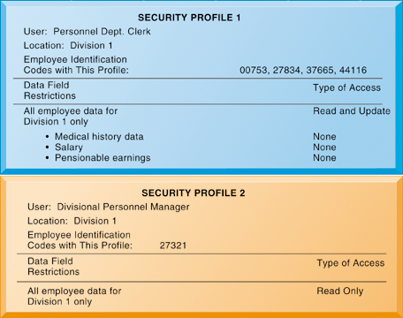
Essentials of Management Information Systems
Chapter 8 Securing Information Systems
Components of an organizational framework for security and control
Security Profiles for a Personnel System
Figure 8.3
These two examples represent two security profiles or data security patterns that might be found in a personnel system. Depending on the security profile, a user would have certain restrictions on access to various systems, locations, or data in an organization.
Notes:
This graphic illustrates the security allowed for two sets of users of a personnel database that contains sensitive information such as employees’ salaries and medical histories. Divisional managers cannot update the system but can read all employee data fields for his or her division, including medical history and salary. Clerical employees who input employee data into the system can update the system but can neither read nor update sensitive fields. These security profiles are based on access rules supplied by business groups in the firm.

Slide 35
Essentials of Management Information Systems
Chapter 8 Securing Information Systems
Components of an organizational framework for security and control
Disaster Recovery Planning and Business Continuity Planning
Disaster recovery planning: Devises plans for restoration of disrupted services
Business continuity planning: Focuses on restoring business operations after disaster
  Both types of plans needed to identify firm’s most critical systems
  Business impact analysis to determine impact of an outage
  Management must determine which systems restored first
Notes:
This slide continues the discussion of essential activities a firm performs to maximize security and control, here looking at planning for activities should a disaster occur, such as a flood, earthquake, or power outage. Note that disaster recovery plans focus primarily on the technical issues involved in keeping systems up and running, such as which files to back up and the maintenance of backup computer systems or disaster recovery services. The text provides the example of MasterCard, which maintains a duplicate computer center in Kansas City, Missouri, to serve as an emergency backup to its primary computer center in St. Louis.
Ask students why it is important that both business managers and information systems specialists work together on these plans.

Slide 36
Essentials of Management Information Systems
Chapter 8 Securing Information Systems
Components of an organizational framework for security and control
The Role of Auditing
MIS audit
  Examines firm’s overall security environment as well as controls governing individual information systems
  Reviews technologies, procedures, documentation, training, and personnel
  May even simulate disaster to test response of technology, IS staff, other employees
  Lists and ranks all control weaknesses and estimates probability of their occurrence.
  Assesses financial and organizational impact of each threat
Notes:
This slide looks at the role of auditing. An MIS audit enables a firm to determine if existing security measures and controls are effective.

Slide 37
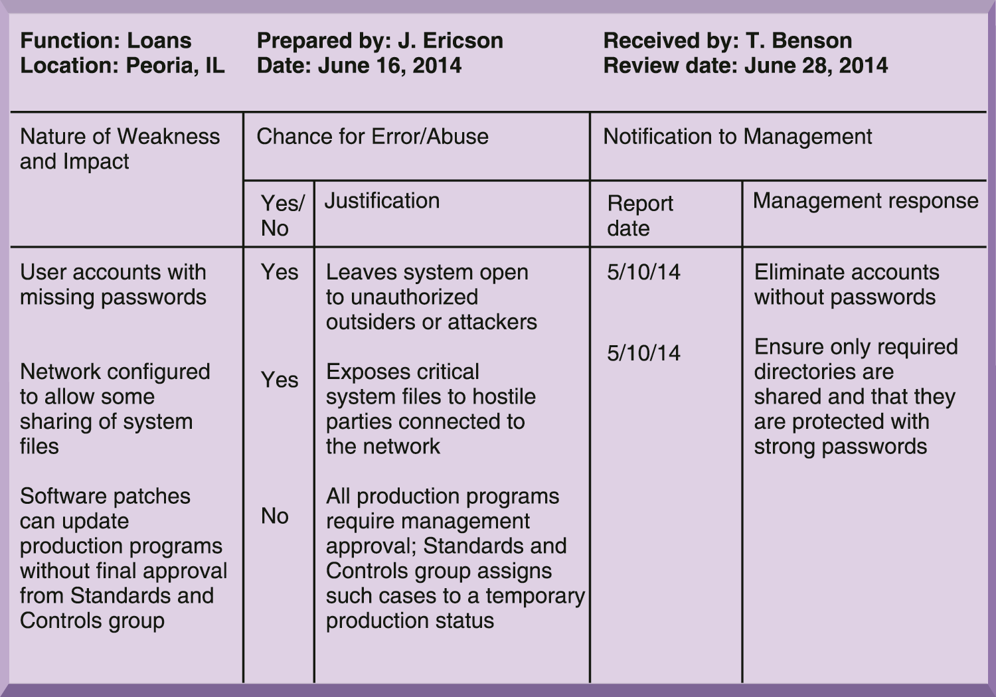
Essentials of Management Information Systems
Chapter 8 Securing Information Systems
What are the most important tools and technologies for safeguarding
information resources?
Sample Auditor’s List of Control Weaknesses
Figure 8.4
This chart is a sample page from a list of control weaknesses that an auditor might find in a loan system in a local commercial bank. This form helps auditors record and evaluate control weaknesses and shows the results of discussing those weaknesses with management, as well as any corrective actions taken by management.
Notes:
This graphic illustrates a sample page from an auditor’s listing of control weaknesses for a loan system. It includes a section for notifying management of such weaknesses and for management’s response. Management is expected to devise a plan for countering significant weaknesses in controls.

Slide 38
Essentials of Management Information Systems
Chapter 8 Securing Information Systems
Most important tools and technologies for safeguarding information resources
Identity Management and Authentication
  Authentication
    Password systems
    Tokens
    Smart cards
    Biometric authentication
      Fingerprints, irises, voices
Notes:
This slide begins a look at the technologies and tools an organization can use to secure systems and data, ensure system availability, and ensure data quality. Here, techniques for preventing unauthorized access to a system are listed. Ask students what the difference between authentication and authorization is. Have any students used authentication methods other than passwords to access a system?

Slide 39
Essentials of Management Information Systems
Chapter 8 Securing Information Systems
Most important tools and technologies for safeguarding information resources
Firewalls, Intrusion Detection Systems, and Antivirus Software
Firewall:
  Combination of hardware and software that prevents unauthorized access to network
  Technologies include:
    Packet filtering
    Stateful inspection
    Network address translation (NAT)
    Application proxy filtering
Notes:
This slide looks at two methods to prevent intruders from accessing private networks. To create a strong firewall, an administrator must maintain detailed internal rules identifying the people, applications, or addresses that are allowed or rejected. Firewalls can deter, but not completely prevent, network penetration by outsiders and should be viewed as one element in an overall security plan.
Ask students to differentiate between the screening technologies listed here. Note that these are often used in combination. Ask students if they use firewall software on their own computers. Most will not know. Firewalls are built into cable and DSL modems. Additional software firewalls are installed by the operating system, or as a part of consumer software security packages.

Slide 40
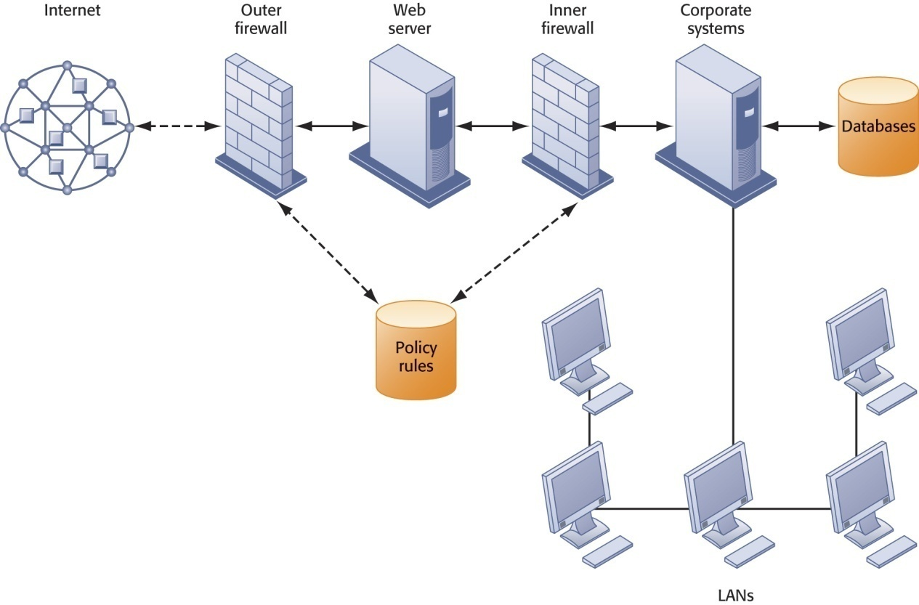
Essentials of Management Information Systems
Chapter 8 Securing Information Systems
Most important tools and technologies for safeguarding information resources
A Corporate Firewall
Figure 8.5
The firewall is placed between the firm’s private network and the public Internet or another distrusted network to protect against unauthorized traffic.
Notes:
This graphic illustrates the use of firewalls on a corporate network. Notice that here, a second “inner” firewall protects the Web server from access through the internal network.

Slide 41
Essentials of Management Information Systems
Chapter 8 Securing Information Systems
Most important tools and technologies for safeguarding information resources
Intrusion detection systems:
  Monitor hot spots on corporate networks to detect and deter intruders.
  Examine events as they are happening to discover attacks in progress.
Antivirus and antispyware software:
  Check computers for presence of malware and can often eliminate it as well.
  Require continual updating.
Unified Threat Management (UTM) systems
Notes:
This slide looks at additional tools to prevent unwanted intruders and software from accessing the network. Ask students what antivirus and antispyware tools they use. Ask why these tools require continual updating.

Slide 42
Essentials of Management Information Systems
Chapter 8 Securing Information Systems
Most important tools and technologies for safeguarding information resources
Securing Wireless Networks
WEP security can be improved:
  Activating it
  Assigning unique name to network’s SSID
  Using it with VPN technology
Wi-Fi Alliance finalized WPA2 specification, replacing WEP with stronger standards
  Continually changing keys
  Encrypted authentication system with central server
Notes:
This slide looks at the tools and technologies used to secure wireless networks. Ask students with laptops what types of wireless security they have. Ask students who have a wireless network at home if it is protected by WEP. Is their home network “secure?”

Slide 43
Essentials of Management Information Systems
Chapter 8 Securing Information Systems
Most important tools and technologies for safeguarding information resources
Encryption and Public Key Infrastructure
Encryption:
  Transforming text or data into cipher text that cannot be read by unintended recipients
  Two methods for encryption on networks
    Secure Sockets Layer (SSL) and successor Transport Layer Security (TLS)
    Secure Hypertext Transfer Protocol (S-HTTP)
Notes:
This slide discusses the use of encryption to ensure that data traveling along networks cannot be read by unauthorized users. Ask students to explain the difference between symmetric key encryption and public key encryption. (In symmetric key encryption, the sender and receiver establish a secure Internet session by creating a single encryption key and sending it to the receiver so both the sender and receiver share the same key. Public key encryption uses two keys: one shared (or public) and one totally private. The keys are mathematically related so that data encrypted with one key can be decrypted using only the other key. To send and receive messages, communicators first create separate pairs of private and public keys. The public key is kept in a directory and the private key must be kept secret. The sender encrypts a message with the recipient’s public key. On receiving the message, the recipient uses his or her private key to decrypt it.
Ask students why public key encryption is stronger than symmetric key encryption.
Note that the strength of an encryption key is measured by its bit length. Today, a typical key will be 128 bits long (a string of 128 binary digits).

Slide 44
Essentials of Management Information Systems
Chapter 8 Securing Information Systems
Most important tools and technologies for safeguarding information resources
Encryption and Public Key Infrastructure
Two methods of encryption
  Symmetric key encryption
    Sender and receiver use single, shared key
  Public key encryption
    Uses two, mathematically related keys: public key and private key
    Sender encrypts message with recipient’s public key
    Recipient decrypts with private key

Slide 45
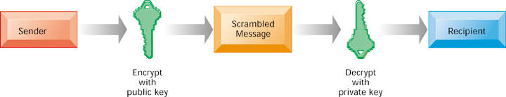
Essentials of Management Information Systems
Chapter 8 Securing Information Systems
Most important tools and technologies for safeguarding information resources
Public Key Encryption
A public key encryption system can be viewed as a series of public and private keys that lock data when they are transmitted and unlock the data when they are received. The sender locates the recipient’s public key in a directory and uses it to encrypt a message. The message is sent in encrypted form over the Internet or a private network. When the encrypted message arrives, the recipient uses his or her private key to decrypt the data and read the message.
Figure 8.6
Notes:
This graphic illustrates the steps in public key encryption. The sender encrypts data using the public key of the recipient; data encrypted with this public key can only be decrypted with the recipient’s private key.

Slide 46
Essentials of Management Information Systems
Chapter 8 Securing Information Systems
Most important tools and technologies for safeguarding information resources
Digital certificate:
  Data file used to establish the identity of users and electronic assets for protection of online transactions
  Uses certification authority (CA) to validate a user’s identity
  CA verifies user’s identity, stores information in CA server, which generates encrypted digital certificate containing owner ID information and copy of owner’s public key
Public key infrastructure (PKI)
  Use of public key cryptography working with certificate authority
  Widely used in e-commerce
Notes:
This slide looks at the use of digital certificates as a tool to help protect online transactions. Digital certificates are used in conjunction with public key encryption to validate the identities of two parties in a transaction before data is exchanged.

Slide 47
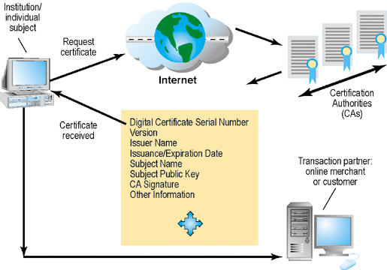
Essentials of Management Information Systems
Chapter 8 Securing Information Systems
Most important tools and technologies for safeguarding information resources
Digital Certificates
Figure 8.7
Digital certificates help establish the identity of people or electronic assets. They protect online transactions by providing secure, encrypted, online communication.
Notes:
This graphic illustrates the process for using digital certificates. The institution or individual requests a certificate over the Internet from a CA; the certificate received from the CA can then be used to validate a transaction with an online merchant or customer.
What do students believe might be a weakness of public key encryption? [Answer: the private keys need to be stored in a digital device, most likely a PC. These devices are easily penetrated and the private key disclosed.]

Slide 48
Essentials of Management Information Systems
Chapter 8 Securing Information Systems
Most important tools and technologies for safeguarding information resources
Ensuring System Availability
Online transaction processing requires 100 percent availability, no downtime.
Fault-tolerant computer systems
  For continuous availability, e.g., stock markets
  Contain redundant hardware, software, and power supply components that create an environment that provides continuous, uninterrupted service
High-availability computing
  Helps recover quickly from crash
  Minimizes, does not eliminate, downtime
Notes:
This slide and the next look at technologies and tools for ensuring system availability. Ask students why online transaction processing requires 100 percent availability. The reason: without near 100% availability, firms would have to stop their business literally by not taking any new orders.
Note that firms with heavy e-commerce processing or for firms that depend on digital networks for their internal operations require at minimum high-availability computing, using tools such as backup servers, distribution of processing across multiple servers, high-capacity storage, and good disaster recovery and business continuity plans.

Slide 49
Essentials of Management Information Systems
Chapter 8 Securing Information Systems
Most important tools and technologies for safeguarding information resources
Ensuring System Availability
Recovery-oriented computing
  Designing systems that recover quickly with capabilities to help operators pinpoint and correct faults in multicomponent systems
Controlling network traffic
  Deep packet inspection (DPI) (video and music blocking)
Security outsourcing
  Managed security service providers (MSSPs)
Notes:
This slide continues the discussion of techniques to minimize downtime and improve network performance. Deep packet inspection enables a network to sort low-priority data packets from high-priority ones in order to improve performance for business critical communication. Ask students what types of network traffic would be suitable for assigning lower priority in a business setting?

Slide 50
Essentials of Management Information Systems
Chapter 8 Securing Information Systems
Most important tools and technologies for safeguarding information resources
Security Issues for Cloud Computing
Cloud computing
  Highly distributed computing, difficult to track unauthorized activities
  Cloud users should ask for proof of security and privacy procedures, including encryption
  Service level agreements (SLAs)
Notes:
Cloud computing offers new opportunities for mischief, but also is in some respects more secure than standard data center corporate computing. The largest kind of cloud security issue so far has been downtime and system crashes rather than malware or hacker intrusions. If a major cloud data center goes down, the load can typically be picked up by other data centers. But sometimes this is not possible because other data centers are at capacity already. A widespread failure in Amazon.com’s Web services division in April 2011 lasted for several days and caused many Web sites to shut down or reduce service. Obviously, Amazon did not have backup capacity to handle the problem.

Slide 51
Essentials of Management Information Systems
Chapter 8 Securing Information Systems
Most important tools and technologies for safeguarding information resources
Security Issues for the Mobile Digital Platform
Mobile platforms
  Mobile device management tools for authorization and inventory
  Data loss prevention technology
  Mobile security policies: platform, software, procedures, security products
  Encryption
  BYOD
  Mobile protective software products
Notes:
Ask students if any have experienced security issues with their cell phone.

Slide 52
Essentials of Management Information Systems
Chapter 8 Securing Information Systems
The Flash Crash: A New Culprit
Interactive Session: Technology
MWEB Business Hacked
Read the Interactive Session and answer the following questions:
What security and control problems are described in this case?
What people, organization, and technology factors contribute to these problems?
How secure is cloud computing? Explain your answer.
If you were in charge of your company’s information systems department, what issues would you want to clarify with prospective vendors?
Would you entrust your corporate systems to a cloud computing provider? Why or why not?

Slide 53
Essentials of Management Information Systems
Chapter 8 Securing Information Systems
Most important tools and technologies for safeguarding information resources
Ensuring Software Quality
Software Metrics: objective assessments of system in form of quantified measurements, e.g.:
  Number of transactions
  Online response time
  Payroll checks printed per hour
  Known bugs per hundred lines of code
Early and regular testing
Walkthrough: review of specification or design document by small group of qualified people
Debugging: process by which errors are eliminated
Notes:
This slide looks at ensuring software quality as a way to improve system quality and reliability by employing software metrics and rigorous software testing. Ongoing use of metrics allows the information systems department and end users to jointly measure the performance of the system and identify problems as they occur.

